Slide 1
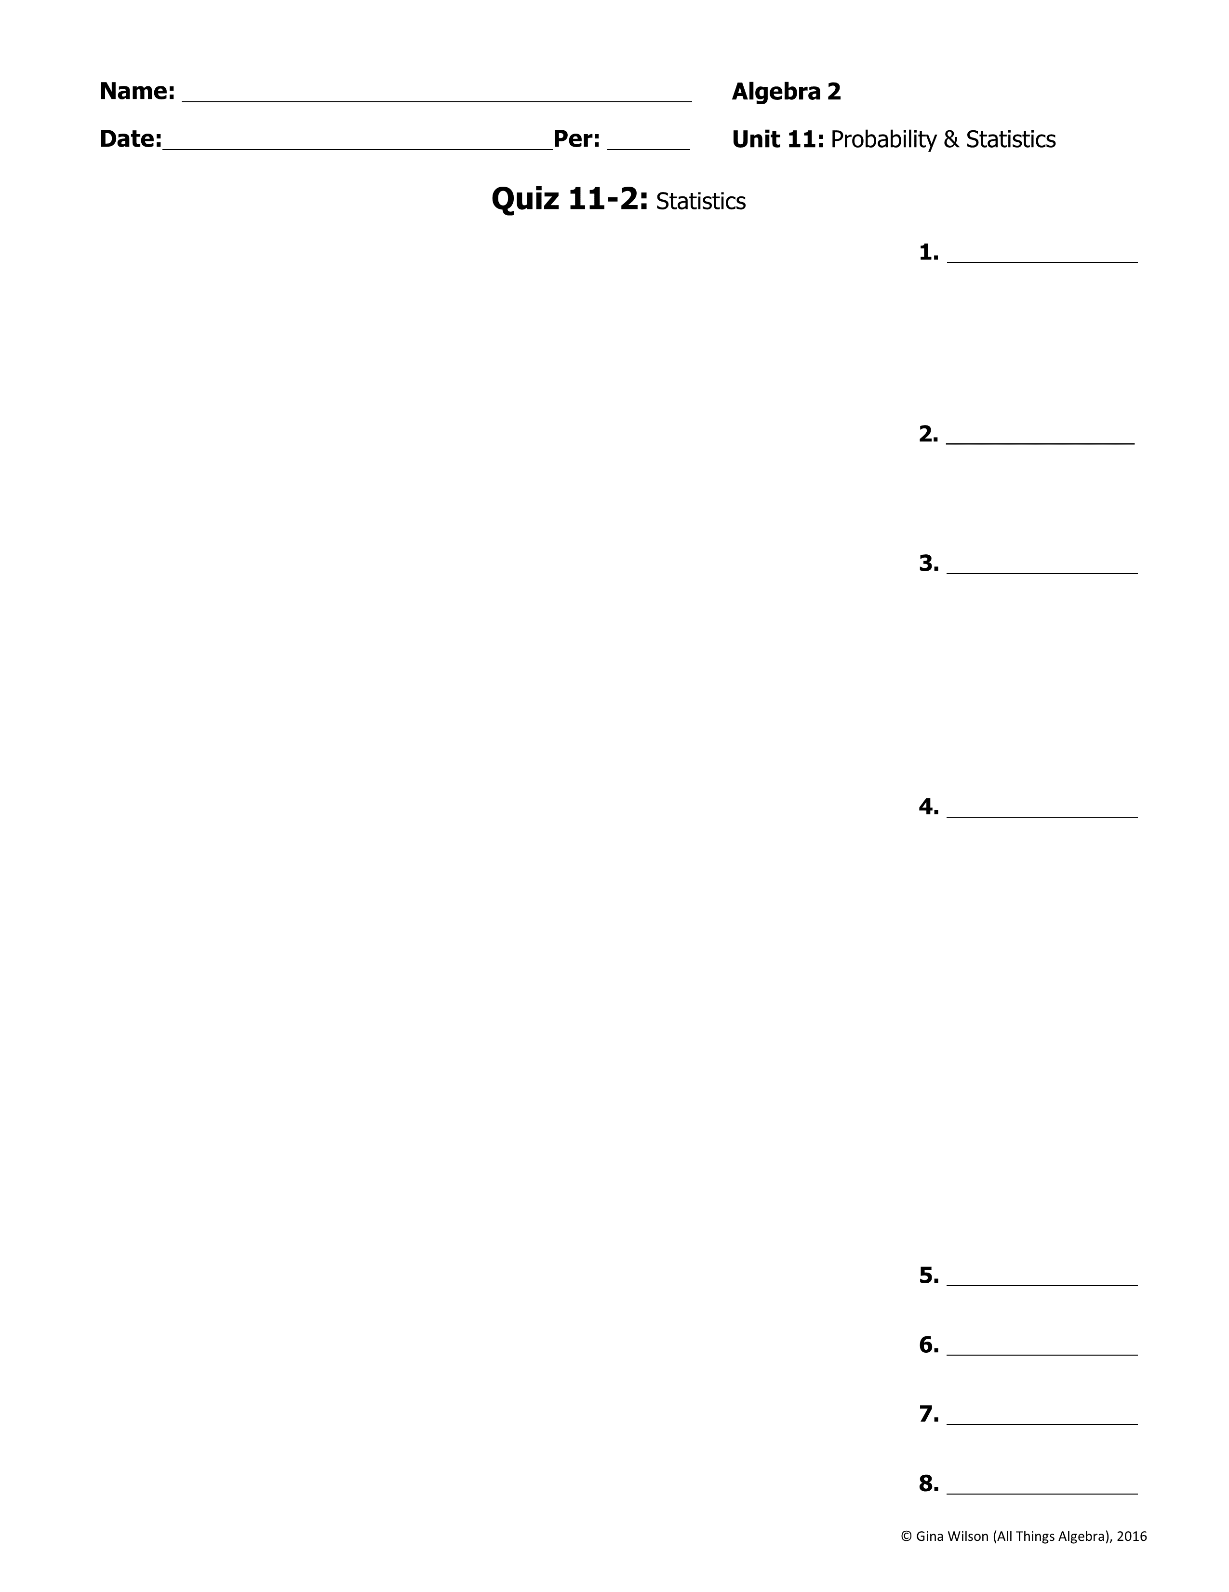
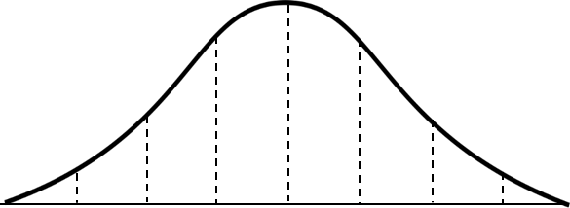
1. The following data represents the number of calories in seven sandwiches at the restaurant: {740, 610, 490, 370, 500, 540, 460}. Find the mean absolute deviation. Round your answer to the nearest hundredth.
2. The speed in miles per hour of each of Sam’s last ten pitches were recorded as follows: {82, 78, 83, 80, 75, 82, 79, 80, 83, 81}. Find the variance. Round your answer to the nearest hundredth.
3. The following data below represents the running times of six movies. Find the standard deviation of the running times. Give your answer to the nearest hundredth of a minute.
Movie | A | B | C | D | E | F
Running Time | 1 hr 47 min | 1 hr 32 min | 2 hr 14 min | 1 hr 56 min | 2 hr 32 min | 3 hr 2 min
4. The gas mileage for a group of cars is normally distributed with a mean of 24 miles per gallon and a variance of 34.81. What is the standard deviation?
Use for questions 5-8: The number of days a group of 250 homes is on the market is normally distributed with a mean 50 and a standard deviation of 13. Label the normal distribution curve, then answer the questions.
5. What percent of the homes are on the market between 11 and 89 days?
6. What is the probability that a home is on the market for at least 37 days?
7. Approximately how many homes were on the market between 37 and 63 days?
8. Approximately how many homes were on the market for no more than 24 days?

Slide 2
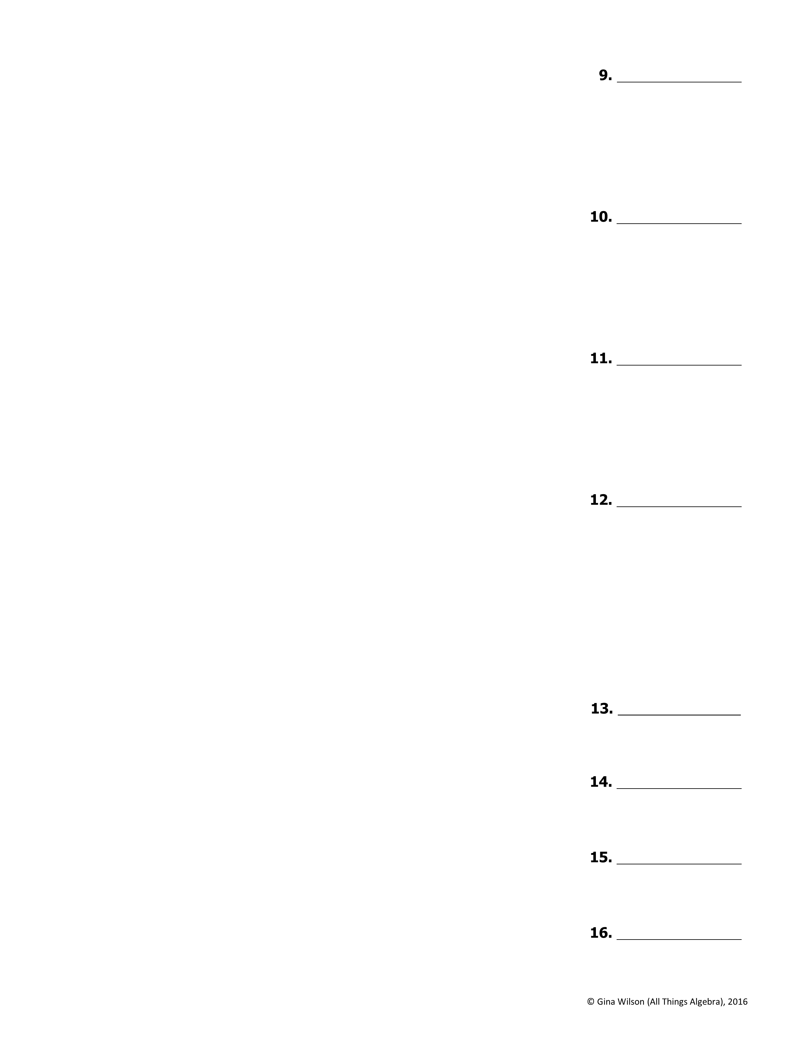
9. The number of text messsages that teenagers send per month is normally distributed with a mean of 3,400 and a standard deviation of 450. If Kendra sent 4,415 text messages last month, find her z-score to the nearest hundredth.
10. The daily high temperatures in Philadelphia for the first 15 days in
February is normally distributed with a standard deviation of 2.5°. If it was 37° on Valentine’s Day with a z-score of 2.4, find the mean temperature.
11. The price of a gallon of milk at various stores is normally distributed with a mean of $2.89 and a standard deviation of $0.2. The price of a gallon of milk at SmartShop has a z-score of -1.3 while the price of a gallon of milk at Wegmans has a z-score of 0.6. How much more is a gallon of milk at Wegmans compared to SmartShop?
12. Mark recently took a road trip across the country. The number of miles he drove each day was normally distributed with a mean of 450. If he drove
431.8 miles on the last day with a z-score of -0.7, what is the standard
deviation?
Use for questions 13-16: The number of points scored by each team in the NHL at the end of the season is normally distributed with a mean of 89 and a standard deviation of 11. Find each probability.
(X represents a data value and z represents a z-score)
13. P(z > 1.3)
14. P(X < 85)
15. P(71 < X < 96)
16. If there are 30 teams, approximately how many scored at least 76 points?

